Slide 1
Bank management system
Presented by:
Khushi kala
Harshit Dawane
Ishika galav
Pralipta priyadarshani jena
Tulsi sethiya
Yogesh waiker

Slide 2
objective
The main objective of this project is to solve financial application of a customer in banking environment in order to nurture the needs of an end banking user by providing ways to perform various tasks.
Our system is password protected and it only allows authorized user to access various functions available in the system.

Slide 3
goals
USER’S SATISFACTION : User can do his operations comfortably without any risk.
SAVING USER’S TIME : User doesn’t need to go to the bank to do small operation.
PROTECTING THE USER : It helps the user to satisfy and provide comfort in his choices, this protection contains user’s account and transaction.
USER FRIENDLY EXPERIENCE : It provides easy transaction of money and using other services.

Slide 4
Modules contained
User Login
Admin login
Create user account
Transaction (Withdraw/Deposit)
Check Transaction History

Slide 5
Technology used
Java Sprint Boot
Postman

Slide 6
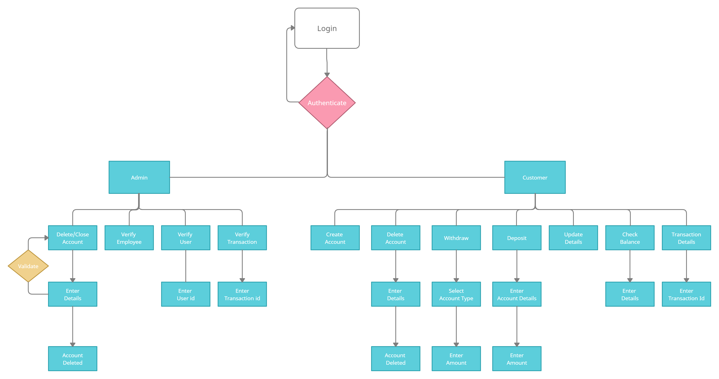
Flow diagram

Slide 7
User login and signup
The main objective of this module is that an existing user can login to his account by providing the required credentials.
For a new user he can sign up and create an account by filling all the required details and later login to the account using same credentials.

Slide 8
TRANSACTION
Transaction module contains 2 features:
Deposition: In this module user needs to provide his name, account no: , account type and sender’s name, account no: and the amount that is been sent.
Withdrawal: In this module user needs to provide his account no:, account type (Savings/Current) and the amount.

Slide 9
Thank you

